Slide 1
Fashionable
Web Components
Bespoke and Ready-To-Use

Slide 2
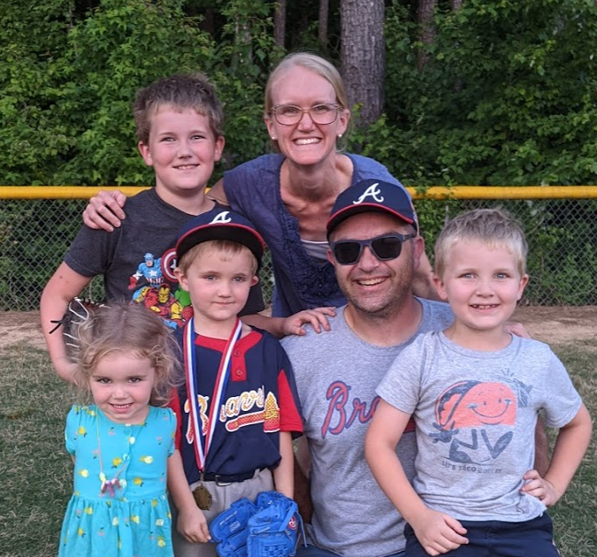
Me - @lukedary
Husband and Father
Red Hatter
Web Platform Champion
Little League Coach
Blender and Godot Enthusiast
Historical/Geographical Tidbits
Grew up in rural, south-eastern Oregon
Cut my HTML teeth on Geocities
Worked in: education, finance, health insurance, and environmental monitoring
Using DSL for my internet (22Mbps/<1Mbps)
Notes:
https://twitter.com/lukedary
https://www.linkedin.com/in/lukedary/
https://dev.to/kamiquasi

Slide 3
The Question
Q: Can enterprise-grade web components be extremely custom-tailored while also usable in broader off-the-rack applications?

Slide 4
Enterprise-Grade?
EXPECTATIONS
Stable
Supported
Secure
Scalable
Inclusive
Performant
EXPERIENCE CONCERNS
Development
Creation
Maintenance
Enhancement
Consumers
Usage
Updating
Notes:
https://dev.to/kamiquasi/enterprise-grade-web-components-3352

Slide 5
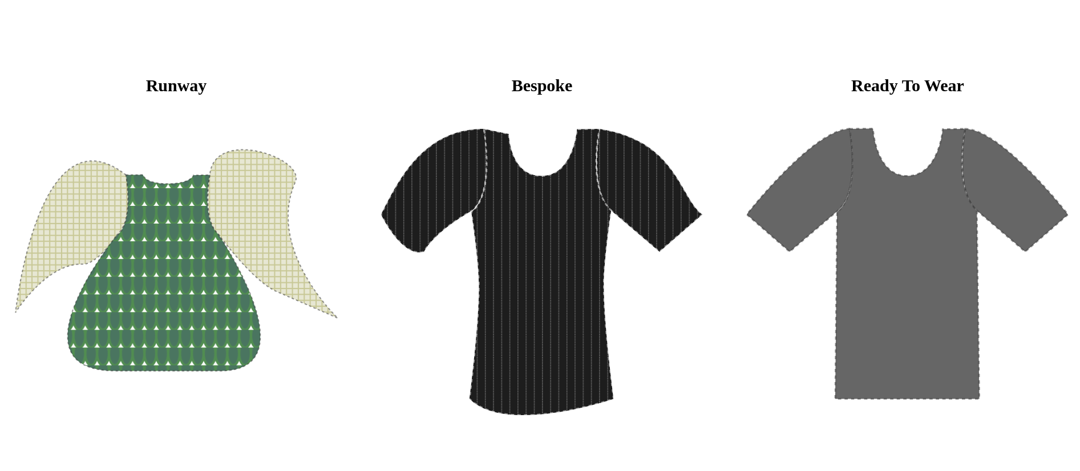
The Analogy
DISCLOSURES
Not a fashion designer
All credit/blame for my knowledge is attributable to Tim Gunn and Heidi Klum shows
Make it work!
Notes:
https://github.com/KamiQuasi/bespoke

Slide 6
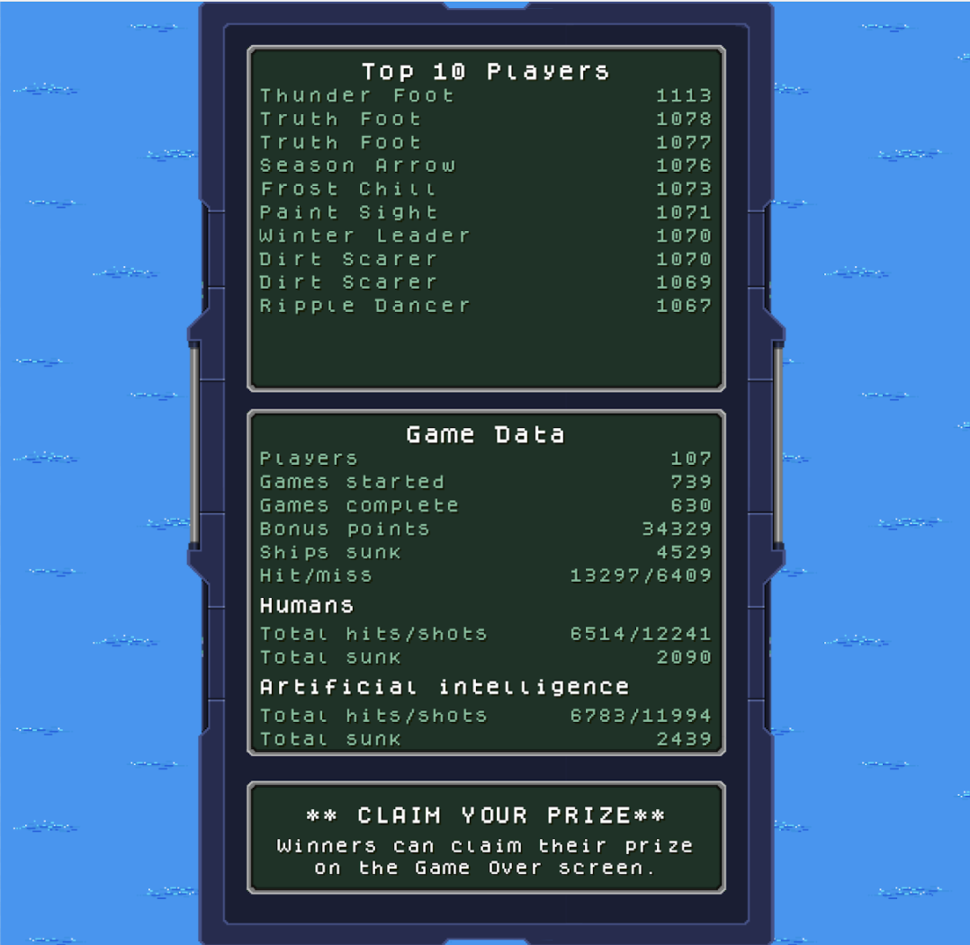
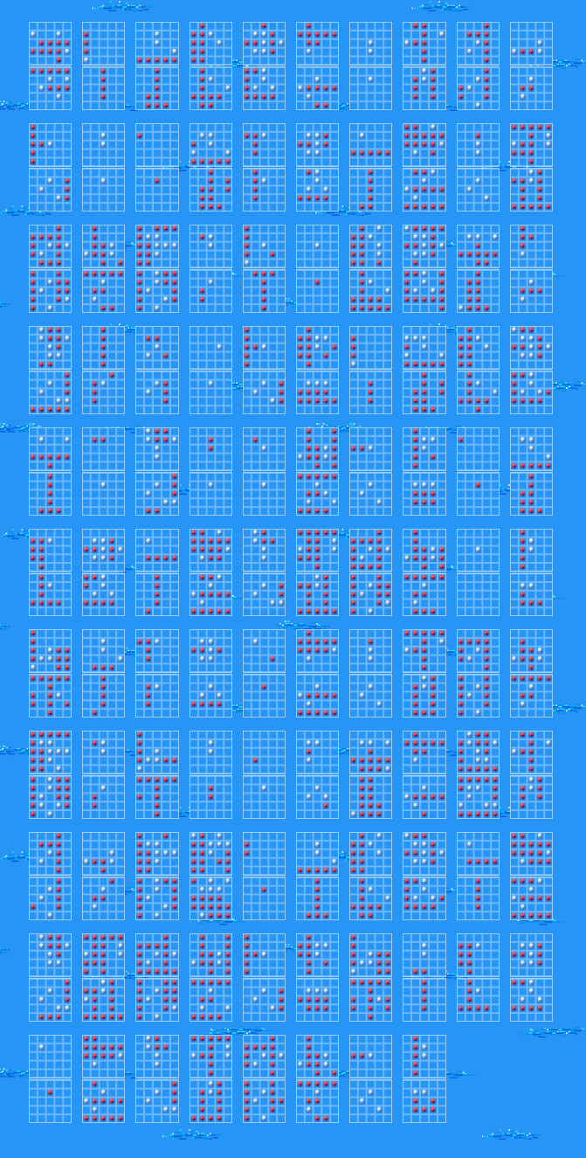
Custom Tailoring
Creative Design Expression
Suited to very specific uses and contexts
Potentially unconcerned with:
Tooling
Libraries/Frameworks
Performance
Modularity
A11y
etc.
Example: 2021 Red Hat Summit Demo
Notes:
The web components used for the Red Hat Summit Demo leaderboard and replay (cpx-websocket and rh-replay respectively) were not meant for wide consumption, but the cpx-websocket one proved to be useful beyond the demo. The replay one, not so much. Demo code: https://github.com/rhdemo/2021-dashboard-ui

Slide 7
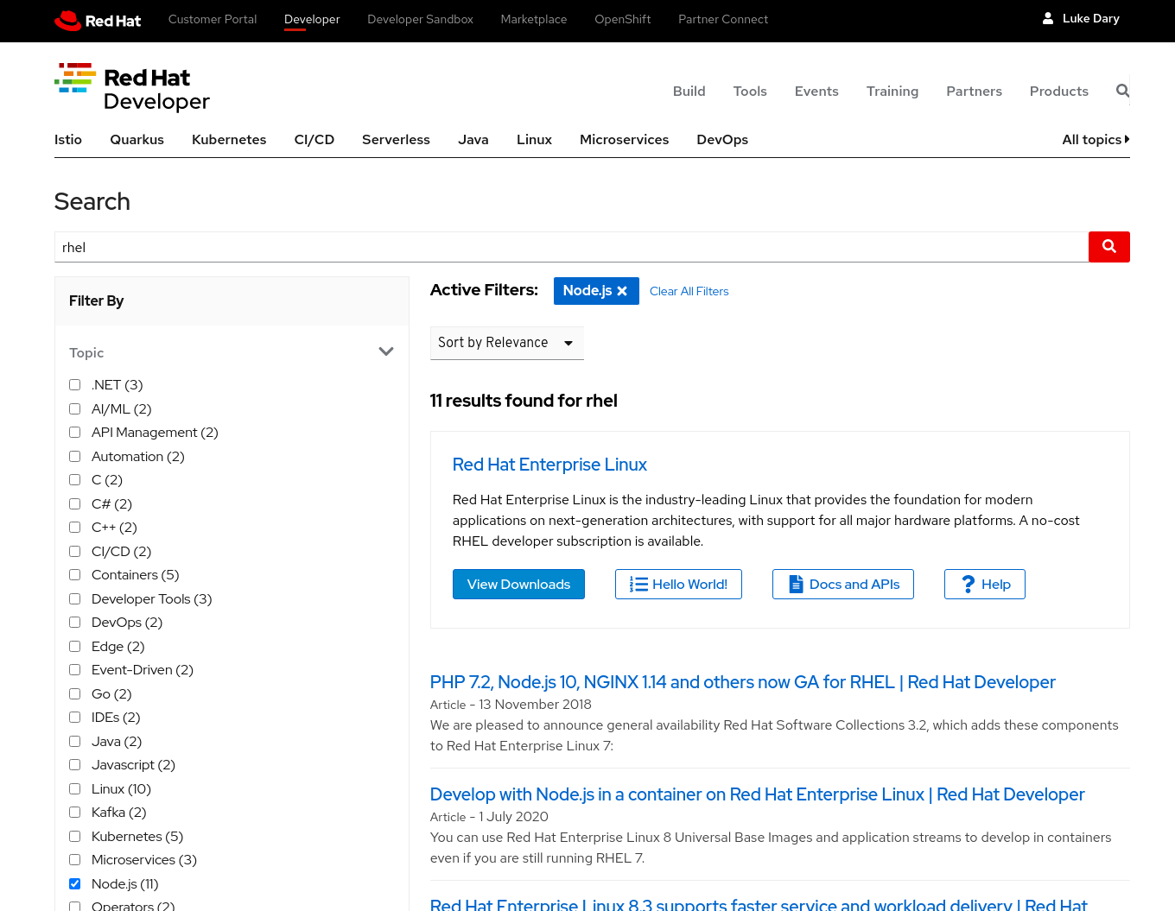
Custom Tailoring
Still usable in production
Not as usable outside of the specific context
Not as obviously maintainable
Notes:
Red Hat Developer Search page: https://developers.redhat.com/search?t=rhel

Slide 8


Ready-To-Use
Concerns
Web APIs
Performance
Tooling
Portability
Developer Experience
A11y
I18n
Enterprise-y Stuff
Etc.
Notes:
https://patternflyelements.com/
https://github.com/chapeaux/

Slide 9
Design -> Refine -> Repeat

Slide 10
A: YES!

Slide 11
Thank you!

